Slide 1


MICROPROCESSOR AND COMPUTER ARCHITECTURE
Data Hazards
Credits:
MPCA Team
Notes:
35

Slide 2
Data Hazards
Data hazards occur when the pipeline changes the order of read/write accesses to operands so that the order differs from the order seen by sequentially executing instructions on an un-pipelined machine.
Consider the execution of following instructions, on our pipelined example processor:
ADD R1, R2, R3
SUB R4, R1, R5
AND R6, R1, R7
ORR R8, R1, R9
XOR R10, R1, R11
Notes:
35
All the instructions after ADD use the result from ADD.

Slide 3
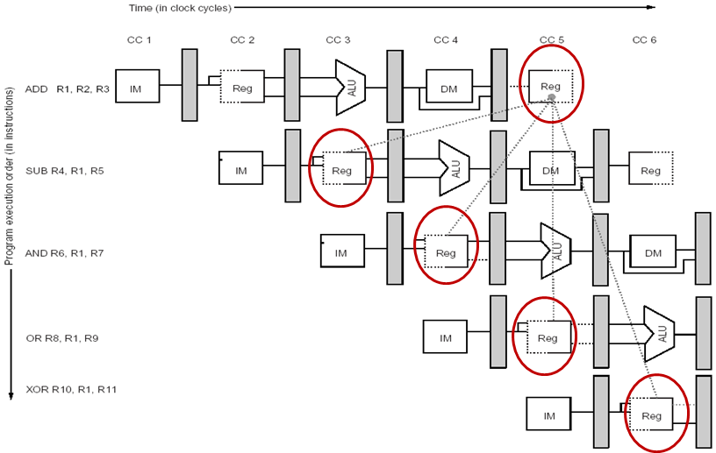
Data Hazards
The use of results from ADD instruction causes hazard since the register is not written until after those instructions read it.
Notes:
35
The ADD instruction writes the result in register R1 only at the WB stage, but SUB instruction reads the value during its ID stage. This is what is called a data hazard. Unless precautions are taken, the SUB instruction will read the wrong value and will use it…
The AND instruction is also affected by this hazard. As we can see from the figure, the write of R1 doesn’t complete until the end of clock cycle 5. Thus, the AND instruction that reads the registers in clock cycle 4 will receive the wrong results.
XOR instruction operates correctly, it reads its inputs (in clock cycle 6) after the ADD has written its result (in clock cycle 5). OR instruction can also be made to work without incurring an hazard, using a simple implementation technique. The technique is to perform the register file reads in the second half of the clock cycle and the writes in the first half.

Slide 4
Data Hazards Classification
Depending on the order of read and write access in the instructions, data hazards could be classified as three types.
Consider two sequential instructions i and j, with i occurring before j. Possible data hazards.
RAW (Read After Write) / True (Flow) Data dependency
j tries to read a source before i writes to it , so j incorrectly gets the old value;
most common type of hazard
Notes:
35

Slide 5
Data Hazards Classification
WAW (Write After Write) / Output Data Dependency
j tries to write an operand before is written by i. The write ends up being performed in wrong order, having i overwrite the operand written by j, the destination containing the operand written by i rather than the one written by j
Present in pipelines that write in more than one pipe stage
WAR (Write After Read) / Anti Data Dependency
j tries to write a destination before it is read by i, so the instruction i incorrectly gets the new value;
This doesn’t happen in scalar pipelines

Slide 6
EXAMPLE
ADD R1, R2, R3
SUB R2, R4, R1
ORR R1, R5, R3
ADD R1, R2, R3
SUB R2, R4, R1
ORR R1, R5, R3
ADD R1, R2, R3
SUB R2, R4, R1
ORR R1, R5, R3
Read After Write
(RAW)
Write After Read
(WAR)
Write After Write
(WAW)
True Data Dependency
(Real)
Anti Data Dependency (Artificial)
Output Data Dependency (Artificial)
What about Read After Read dependency?

Slide 7
Ways to handle Data Hazard
In Software
insert independent instructions (or no-ops)
Ex: MOV R0, R0
re-order instructions
In Hardware
Insert bubbles (i.e. stall the pipeline)
Data Forwarding

Slide 8
OTHER SOLUTIONS
Replication of resources
Split Memory (Instruction Memory & Data Memory)
Partitioning/Overlapping
1st half of the cycle Reg Write
2nd half of the same cycle Reg Read

Slide 9
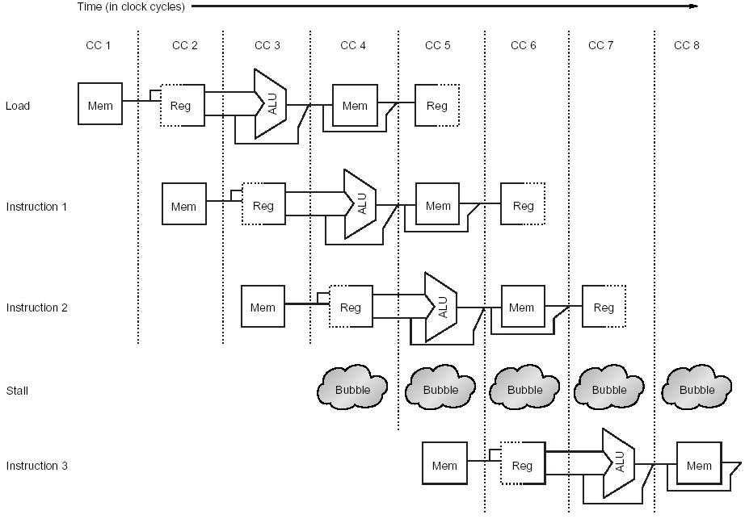
INSERT BUBBLES

Slide 10
STALL CYCLES
Instruction Number | Clock number
 | 1 | 2 | 3 | 4 | 5 | 6 | 7 | 8 | 9 | 10
load | IF | ID | EX | MEM | WB
Instruction i+1 |  | IF | ID | EX | MEM | WB
Instruction i+2 |  |  | IF | ID | EX | MEM | WB
Instruction i+3 |  |  |  | stall | stall | stall | IF | ID | EX | MEM
Instruction i+4 |  |  |  |  |  |  |  | IF | ID | EX
Instruction i+5 |  |  |  |  |  |  |  |  | IF | ID

Slide 11
T
i
m
e
(
i
n
c
l
o
c
k
c
y
c
l
e
s
)
V
a
l
u
e
o
f
C
C
1
C
C
2
C
C
3
C
C
4
C
C
5
C
C
6
C
C
7
C
C
8
C
C
9
C
C
10
C
C
11
r
e
g
i
s
t
e
r
R2
:
1
0
1
0
1
0
1
0
1
0
/
–
2
0
–
2
0
–
2
0
–
2
0
–
2
0
–
2
0
–
2
0
P
r
o
g
r
a
m
e
x
e
c
u
t
i
o
n
o
r
d
e
r
(
i
n
i
n
s
t
r
u
c
t
i
o
n
s
)
s
b
2
R
e
g
u
,
R
1
,
R
3
R
I
M
R
e
g
D
M
STALL
STALL
a
n
d
R
1
2
,
R
2
,
R
5
I
M
R
e
g
D
M
R
e
g
STALL
STALL
o
rr
R
3
,
R
6
,
R
2
I
M
R
e
g
D
M
R
e
g
a
d
d
R
4
,
R
2
,
R
2
I
M
R
e
g
D
M
R
e
g
s
tr
R
5
,
[
R
2, #100]
I
M
R
e
g
D
M
R
e
g

Slide 12
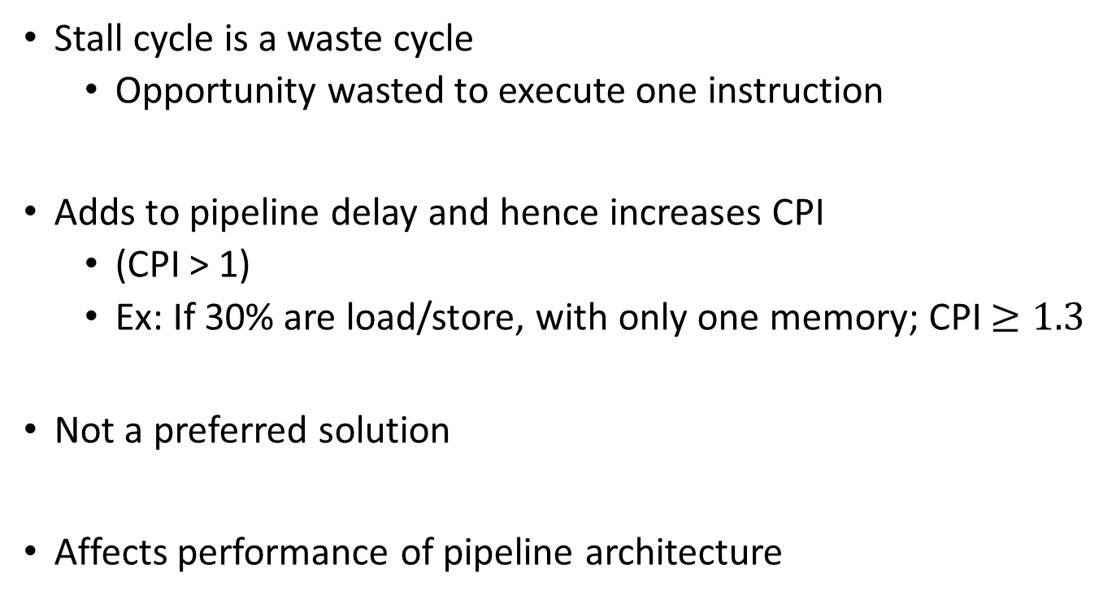
DISADVANTAGE

Slide 13
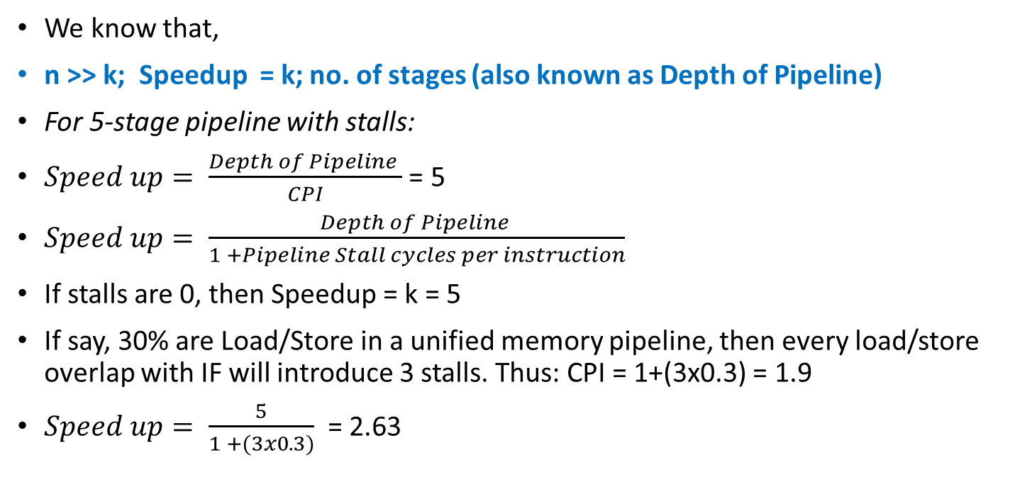
Performance (with stalls)

Slide 14
INSERT NOP OR MOV R0, R0
The compiler can guarantee that no data hazards exist adding NOP or MOV instructions where needed. [Instruction Scheduling]
sub R2, R1, R3
NOP or MOV R0, R0
NOP or MOV R0, R0
and R12, R2, R5 orr R10, R6, R2 add R4, R2, R2 str R5, [R2, #100]
sub R2, R1, R3 and R12, R2, R5 orr R10, R6, R2 add R4, R2, R2 str R5, [R2, #100]

Slide 15
CC1
CC2
CC3
CC4
CC5
CC6
CC7
CC8
sub R2, R1, R3
IM
Reg
ALU
DM
Reg
nop
IM
Reg
ALU
DM
Reg
nop
IM
Reg
ALU
DM
Reg
IM
Reg
ALU
DM
Reg
add R12, R2, R5
Insert enough no-ops (or other instructions that don’t
use register R2) so that data hazard doesn’t occur,

Slide 16
Where are NOPs needed?
sub R2, R1, R3
and R4, R2, R5
orr R8, R2, R6
add R9, R4, R2
rsb R1, R6, R7

Slide 17
Where are NOPs needed?
sub R2, R1, R3
NOP
NOP
and R4, R2, R5
orr R8, R2, R6
NOP
add R9, R4, R2
rsb R1, R6, R7

Slide 18
DATA FORWARDING
We could avoid stalling if we could get to EX stage, the ALU output from “previous instruction” to ALU input for the “current instruction”
Suppose initially, register i holds the number 2i (ie. R3 = 6; R6=12; R8 = 16…)
Result available
IM
Reg
6
8
DM
Reg
add R2, R3, R4
ALU
14
IM
Reg
6
4
DM
Reg
orr R5, R3, R2
ALU
14
Result Required

Slide 19
DATA FORWARDING
Also known as:
Register –bypassing
Short-circuiting
Forwarding handles hazards at both
EX stage
MEM stage

Slide 20
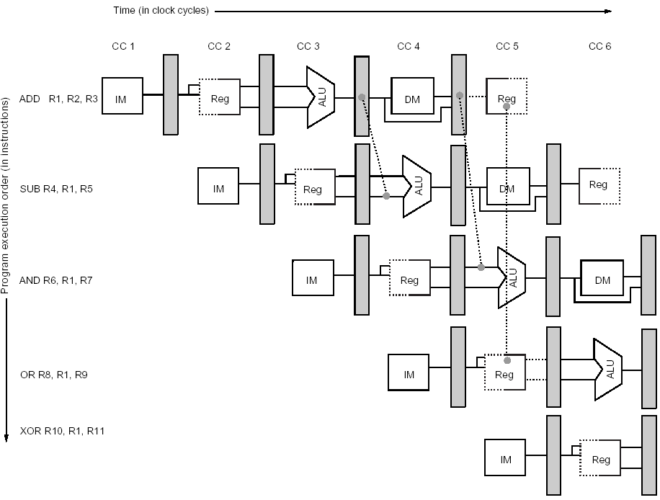
DATA FORWARDING FROM EX AND MEM STAGES

Slide 21
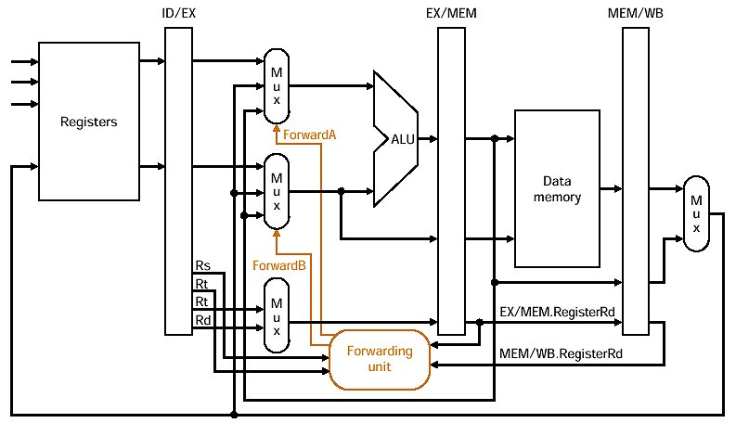
FORWARDING UNIT

Slide 22
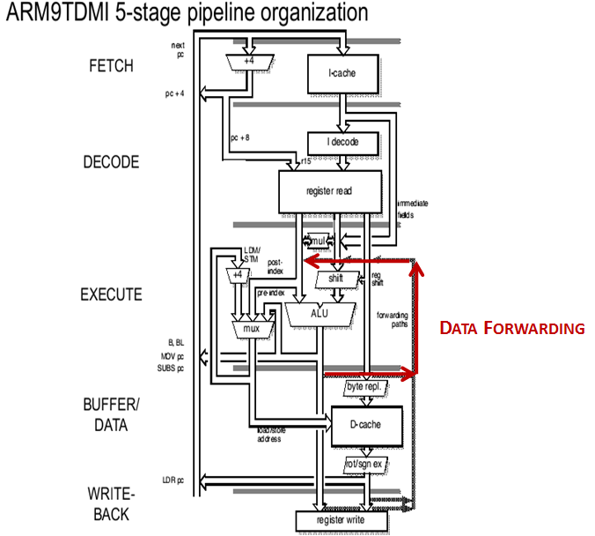
Data Forwarding
Data Dependency
ADD R0, R1, R2, LSL #2
ADC R3, R0, R4, LSR R5
SWI 0X11

Slide 23
Data Hazards
Eliminate the stalls for the hazard involving SUB and AND instructions using a technique called forwarding
Notes:
35
The data hazard, in certain circumstances can be solved using an implementation technique called forwarding. The idea behind the forwarding is that the result produced by ADD is not really needed by the SUB instruction until it is actually produced. If the result can be moved from where the ADD instruction produces it , the EX/MEM register, to where the SUB needs it, the ALU input latches, then the need for a stall can be avoided.
Forwarding works as follow:
The ALU result from EX/MEM register is always fed back to the ALU input latches
If the forwarding hardware detects that the previous ALU operation has written the register corresponding to a source for the current ALU operation, control logic selects the forwarded result as the ALU input, rather than the value read from the register file.
We need to forward results not only from immediately previous instruction, but possible from instructions that started two or three cycles earlier.

Slide 24
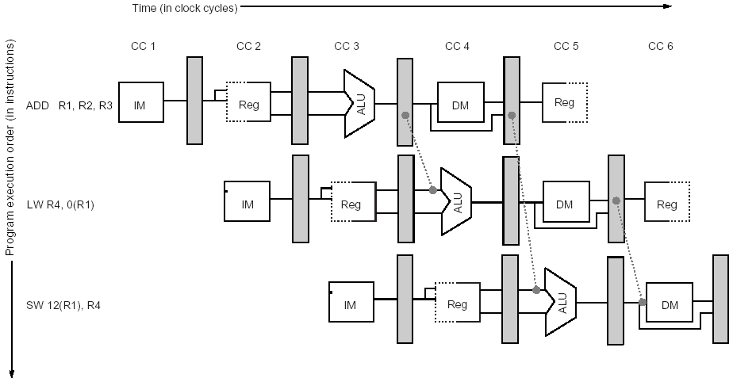
Data Hazards
Store requires an operand during MEM and forwarding is shown here.
The result of the load is forwarded from the output in MEM/WB to the memory input to be stored
In addition the ALU Output is forwarded to ALU input for address calculation for both Load and Store

Slide 25
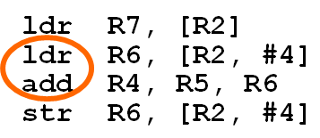

INSTRUCTION SCHEDULING
Reorder the instructions to avoid as many pipeline stalls as possible:
The data hazard occurs on register R6 between the second lw and the add resulting in a stall cycle

Slide 26
ldr R7, [R2]
ldr R6, [R2, #4]
add R4, R5, R6
str R6, [R2, #4]
With forwarding we need to find only one independent instructions to place between them, swapping the ldr instructions works:
ldr R6, [R2, #4]
ldr R7, [R2]
add R4, R5, R6
str R6, [R2, #4]
Without forwarding we need two independent instructions to place between them, so in addition a nop is added.
ldr R6, [R2, #4]
ldr R7, [R2]
NOOP
add R4, R5, R6
str R6, [R2, #4]

Slide 27
EXAMPLE:
a = b + c;
Eliminate dependency
by renaming registers
Before:
After:
ldr R2, =a
ldr R3, =b
add R1, R2, R3
str R1, =a
ldr R2, =e
ldr R3, =f
sub R1, R2, R3
str R1, =d
ldr R2, =a
ldr R3, =b
add R1, R2, R3
str R1, =a
ldr R5, =e
ldr R6, =f
sub R4, R5, R6
str R4, =d
ldr R2, =a
ldr R3, =b
ldr R5, =e
add R1, R2, R3
ldr R6, =f
str R1, =a
sub R4, R5, R6
str R4, =d

Slide 28
Data Hazards Requiring Stalls
Unfortunately not all data hazards can be handled by forwarding. Consider the following sequence:
LW R1, 0(R2)
SUB R4, R1, R5
AND R6, R1, R7
OR R8, R1, R9
The problem with this sequence is that the Load operation will not have data until the end of MEM stage.

Slide 29
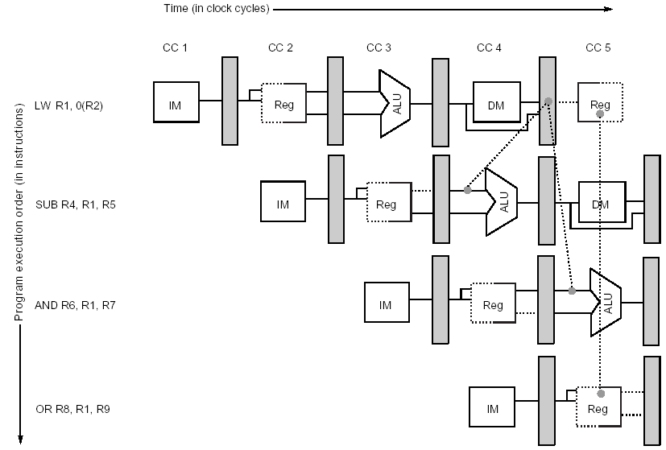
Data Hazards Requiring Stalls
The load instruction can forward the results to AND and OR instruction, but not to the SUB instruction since that would mean forwarding results in “negative” time.

Slide 30
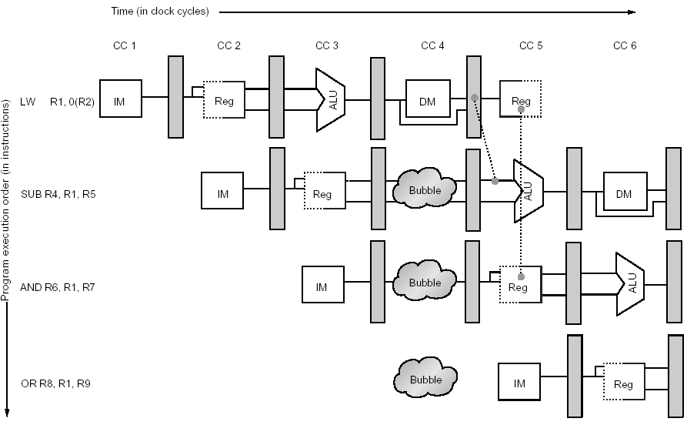
Data Hazards Requiring Stalls
The load interlock causes a stall to be inserted at clock cycle 4, delaying the SUB instruction and those that follow by one cycle.
This delay allows the value to be successfully forwarded onto the next clock cycle

Slide 31
Data Hazards Requiring Stalls
Before stall insertion
LW R1, 0(R2) | IF | ID | EX | MEM | WB
SUB R4, R1, R5 |  | IF | ID | EX | MEM | WB
AND R6, R1, R7 |  |  | IF | ID | EX | MEM | WB
OR R8, R1, R9 |  |  |  | IF | ID | EX | MEM | WB
After stall insertion
LW R1, 0(R2) | IF | ID | EX | MEM | WB
SUB R4, R1, R5 |  | IF | ID | stall | EX | MEM | WB
AND R6, R1, R7 |  |  | IF | stall | ID | EX | MEM | WB
OR R8, R1, R9 |  |  |  | stall | IF | ID | EX | MEM | WB

Slide 32
Compiler Scheduling for Data Hazards
Consider a typical code, such as A = B + C
LW R1, B | IF | ID | EX | MEM | WB
LW R2, C |  | IF | ID | EX | MEM | WB
ADD R3, R1, R2 |  |  | IF | ID | stall | EX | MEM | WB
SW A, R3 |  |  |  | IF | stall | ID | EX | MEM | WB
The ADD instruction must be stalled to allow the load of C to complete.
The SW need not be delayed because the forwarding hardware passes the result from MEM/WB directly to the data memory input for storing.

Slide 33
Compiler Scheduling for Data Hazards
Rather than just allow the pipeline to stall, the compiler could try to schedule the pipeline to avoid the stalls, by rearranging the code
The compiler could try to avoid the generating the code with a load followed by an immediate use of the load destination register.
This technique is called pipeline scheduling or instruction scheduling and is a commonly used technique in modern compilers

Slide 34
Instruction scheduling example
Generate code for our example processor that avoids pipeline stalls from the following sequence:
A = B +C
D = E - F
Solution
LW Rb, B
LW Rc, C
LW Re, E ; swap instructions to avoid stall
ADD Ra, Rb, Rc
LW Rf, f
SW a, Ra ; swap instruction to avoid stall
SUB Rd, Re, Rf
SW d, Rd

Slide 35
Q & A
Pipeline : Data Hazards
Notes:
12/02/20
35

